Slide 1
Hi! This is CS50.
Halloween candy for break today. 🎃
Last live lecture this Fri 11/1, 10:30am–11:45am. Families welcome, ok to watch online if conflict.
CS50 Family Lunch for first years and families this Fri 11/1, 12pm, register at cs50.ly/family.
If you have trouble seeing projector, see live.cs50.io/screen for live feed.
Quiz 7 (the last!) due tomorrow at 10:30am.
Problem Set 7 due Sun 11/3 at 11:59pm.
Supersection tonight at 7:30pm via Zoom.
Lots of tutorials available this week!
Notes:
https://docs.google.com/forms/d/e/1FAIpQLSfBeHcVxjbIPjZbuzGmGCHzY1K4NtsHD7TQ18axtRiP2mi6eA/viewform

Slide 2
This is CS50

Slide 3
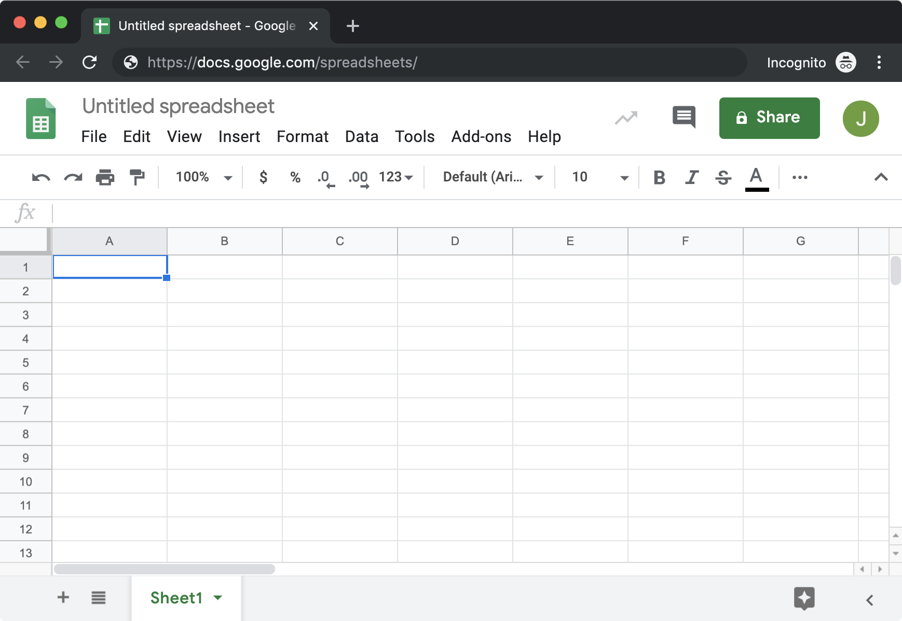

Slide 4
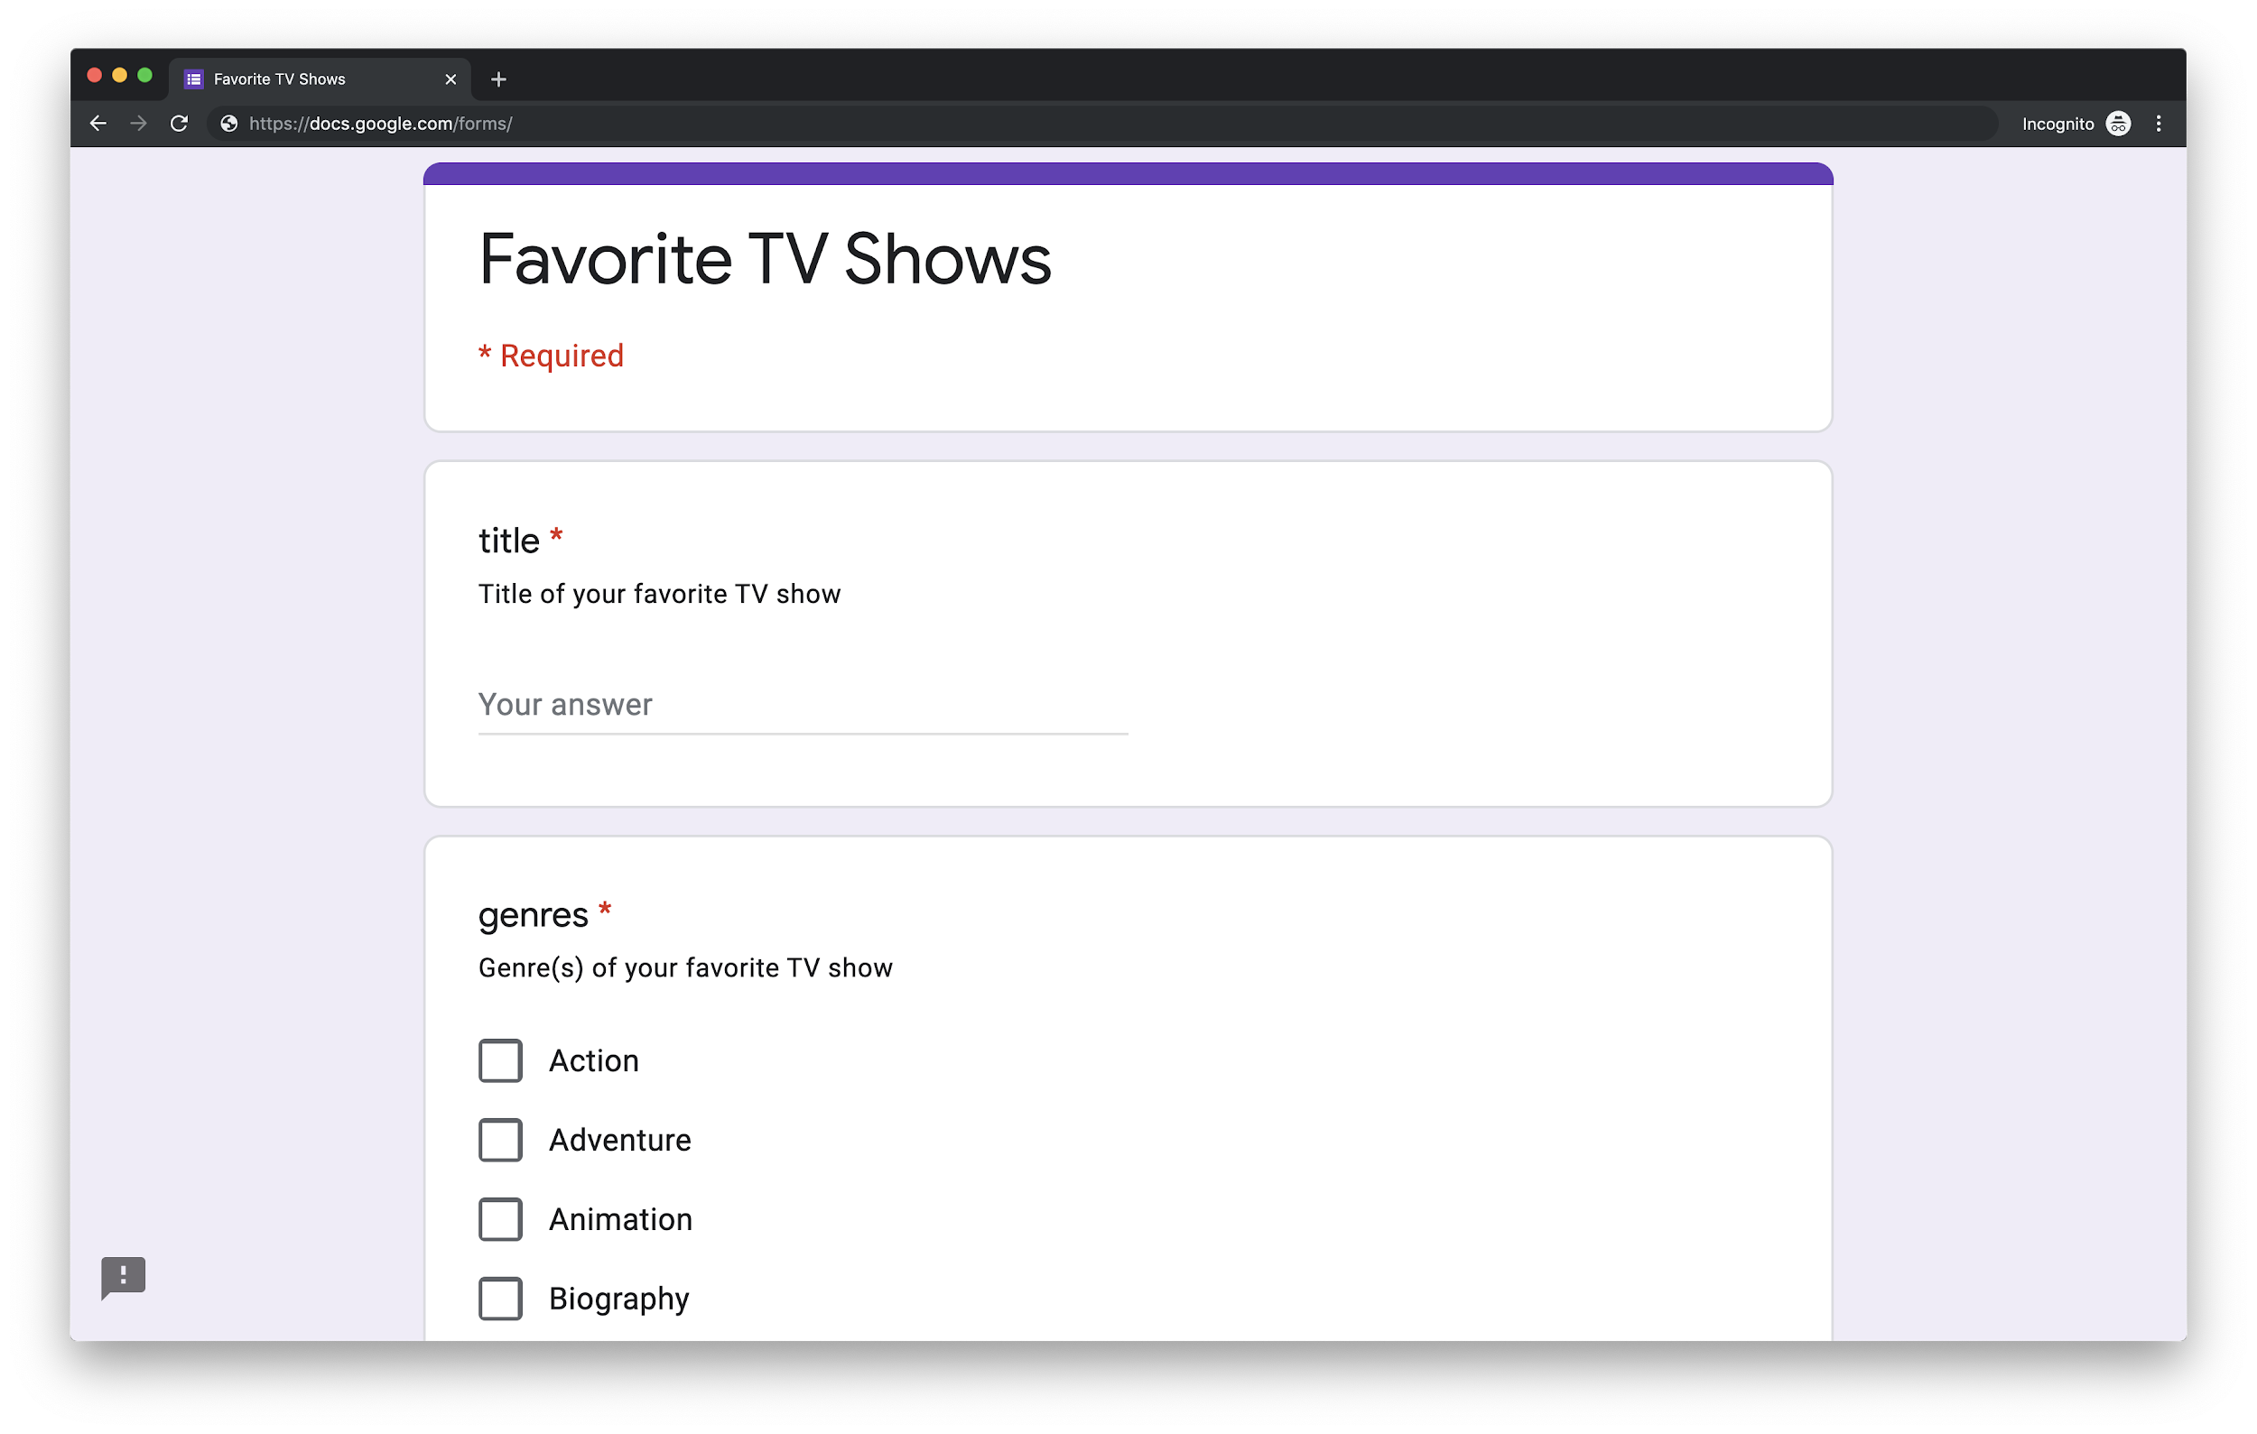
Notes:
https://cs50.ly/shows

Slide 5
cs50.ly/shows

Slide 6
Notes:
https://cs50.ly/shows

Slide 7
relational databases

Slide 8
sqlite3

Slide 9
.mode csv
.import FILE TABLE
.schema

Slide 10
C
R
U
D

Slide 11
CREATE
READ
UPDATE
DELETE

Slide 12
SQL

Slide 13
INSERT
SELECT
UPDATE
DELETE
...

Slide 14
CREATE TABLE table (column type, ...);

Slide 15
BLOB
INTEGER
NUMERIC
REAL
TEXT

Slide 16
BLOB
INTEGER
smallint
integer
bigint
NUMERIC
REAL
TEXT

Slide 17
BLOB
INTEGER
NUMERIC
REAL
real
double precision
TEXT

Slide 18
BLOB
INTEGER
NUMERIC
boolean
date
datetime
numeric(scale,precision)
time
timestamp
REAL
TEXT

Slide 19
BLOB
INTEGER
NUMERIC
REAL
TEXT
char(n)
varchar(n)
text

Slide 20
INSERT INTO table (column, ...) VALUES(value, ...);

Slide 21
SELECT columns FROM table;

Slide 22
AVG
COUNT
DISTINCT
MAX
MIN
...

Slide 23
WHERE
LIKE
LIMIT
GROUP BY
ORDER BY
JOIN
...

Slide 24
SELECT columns FROM table WHERE condition;

Slide 25
UPDATE table SET column=value WHERE condition;

Slide 26
DELETE FROM table WHERE condition;

Slide 27
IMDb
imdb.com/interfaces

Slide 28
title.basics.tsv
tconst tt4786824
titleType tvSeries
primaryTitle The Crown
startYear 2016
genres Drama,History
...

Slide 29
title.basics.tsv
tconst tt4786824
titleType tvSeries
primaryTitle The Crown
startYear 2016
genres Drama,History
...

Slide 30
title.basics.tsv
tconst tt4786824
titleType tvSeries
primaryTitle The Crown
startYear 2016
genres Drama,History
...

Slide 31
title.basics.tsv
tconst tt4786824
titleType tvSeries
primaryTitle The Crown
startYear 2016
genres Drama,History
...

Slide 32
title.basics.tsv
tconst tt4786824
titleType tvSeries
primaryTitle The Crown
startYear 2016
genres Drama,History
...

Slide 33
title.basics.tsv
tconst tt4786824
titleType tvSeries
primaryTitle The Crown
startYear 2016
genres Drama,History
...

Slide 34
title.basics.tsv
tconst tt4786824
titleType tvSeries
primaryTitle The Crown
startYear 2016
genres Drama,History
...
Notes:
https://www.imdb.com/title/tt4786824/

Slide 35
Please don’t eat candy in here btw :)

Slide 36
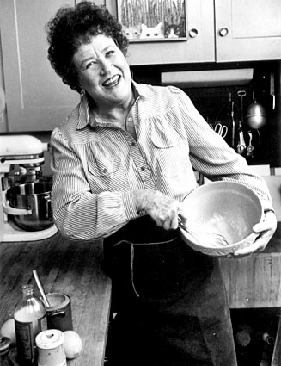
Notes:
http://www.kitchenboudoir.com/2012/06/reine-de-saba-julia-childs-queen-of.html

Slide 37
db = cs50.SQL("sqlite:///shows.db")

Slide 38
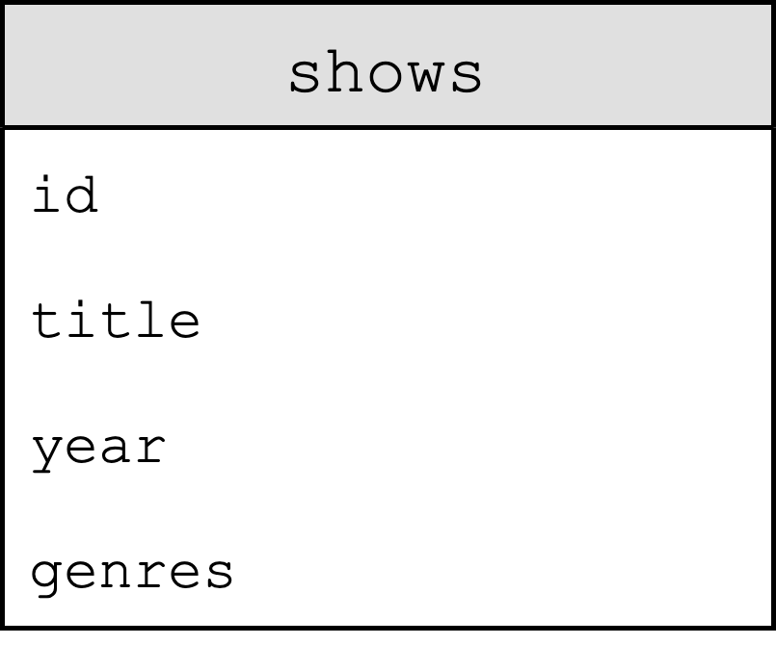

Slide 39
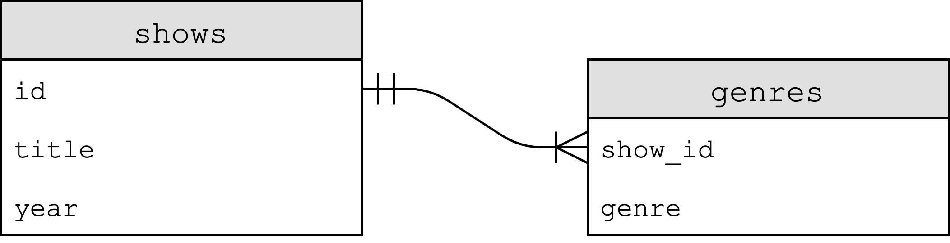

Slide 40
title.basics.tsv
tconst tt4786824
titleType tvSeries
primaryTitle The Crown
startYear 2016
genres Drama,History
...

Slide 41
name.basics.tsv
nconst nm2946516
primaryName Claire Foy
birthYear 1984
...

Slide 42
title.principals.tsv
tconst tt4786824
nconst nm2946516
category actress
...

Slide 43
title.ratings.tsv
tconst tt4786824
averageRating 8.7
numVotes 88529
...

Slide 44
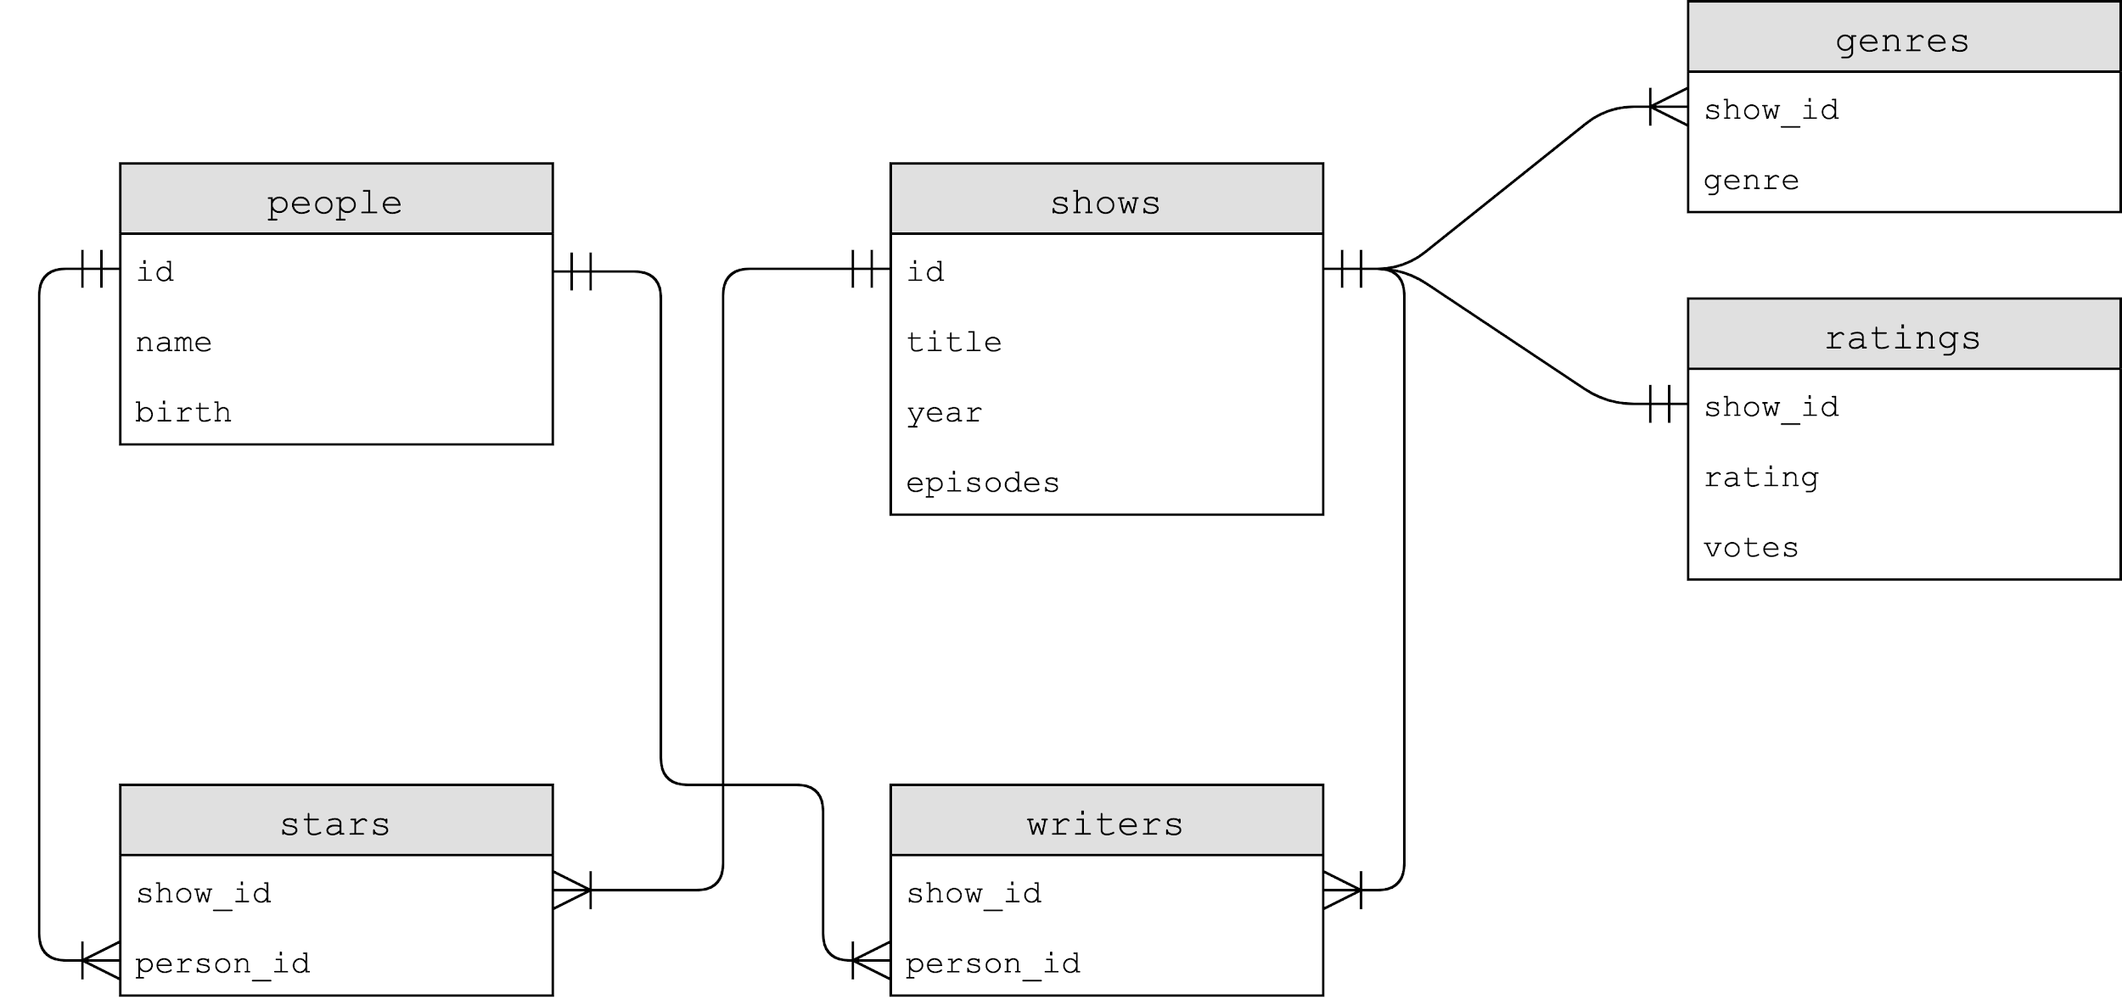

Slide 45
PRIMARY KEY
FOREIGN KEY
UNIQUE
INDEX

Slide 46
AUTOINCREMENT
NOT NULL

Slide 47
indexes

Slide 48
B-trees

Slide 49
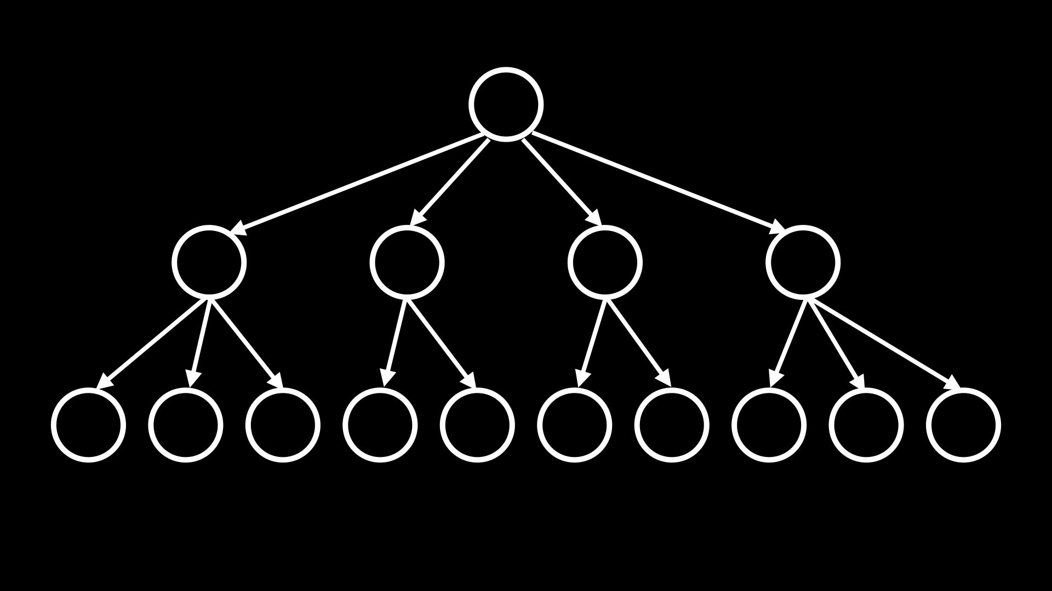

Slide 50
CREATE INDEX name ON table (column, ...);
Notes:
CREATE INDEX "title_index" ON "shows" ("primaryTitle");

Slide 51
CREATE INDEX name ON table (column, ...);
Notes:
SELECT title FROM shows WHERE id IN (SELECT show_id FROM stars WHERE person_id = (SELECT id FROM people WHERE name = "Ellen DeGeneres"));

Slide 52
CREATE INDEX name ON table (column, ...);
Notes:
SELECT title FROM people JOIN stars ON people.id = stars.person_id JOIN shows ON stars.show_id = shows.id WHERE name = "Ellen DeGeneres";

Slide 53
CREATE INDEX name ON table (column, ...);
Notes:
SELECT title FROM people, stars, shows WHERE people.id = stars.person_id AND stars.show_id = shows.id AND name = "Ellen DeGeneres";

Slide 54
CREATE INDEX name ON table (column, ...);
Notes:
CREATE INDEX person_index ON stars (person_id);
CREATE INDEX show_index ON stars (show_id);
CREATE INDEX name_index ON people (name);

Slide 55
DB Browser for SQLite
sqlitebrowser.org

Slide 56
race conditions

Slide 57
rows = db.execute("SELECT likes FROM posts WHERE id=?", id);
likes = rows[0]["likes"]
db.execute("UPDATE posts SET likes = ?", likes + 1);

Slide 58
rows = db.execute("SELECT likes FROM posts WHERE id=?", id);
likes = rows[0]["likes"]
db.execute("UPDATE posts SET likes = ?", likes + 1);

Slide 59
BEGIN TRANSACTION
COMMIT
ROLLBACK

Slide 60
SQL injection attacks

Slide 61
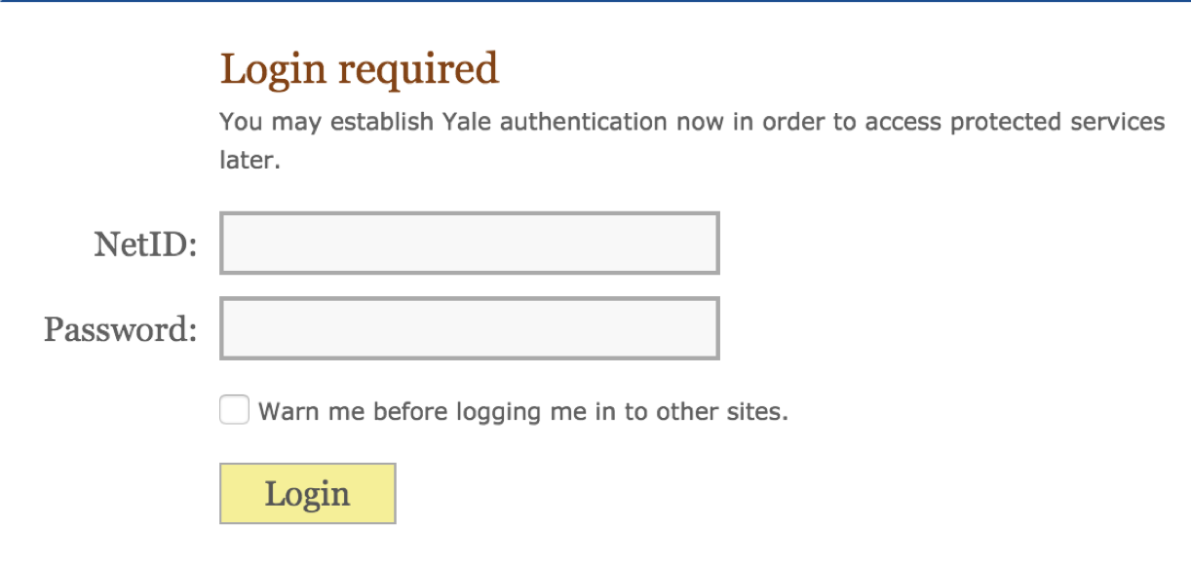

Slide 62
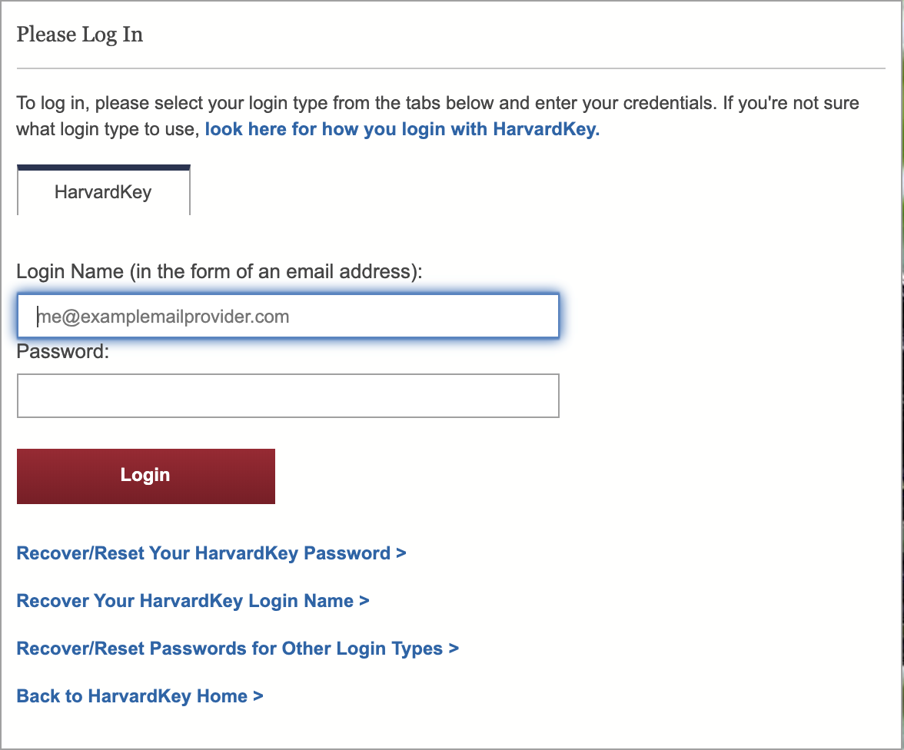

Slide 63
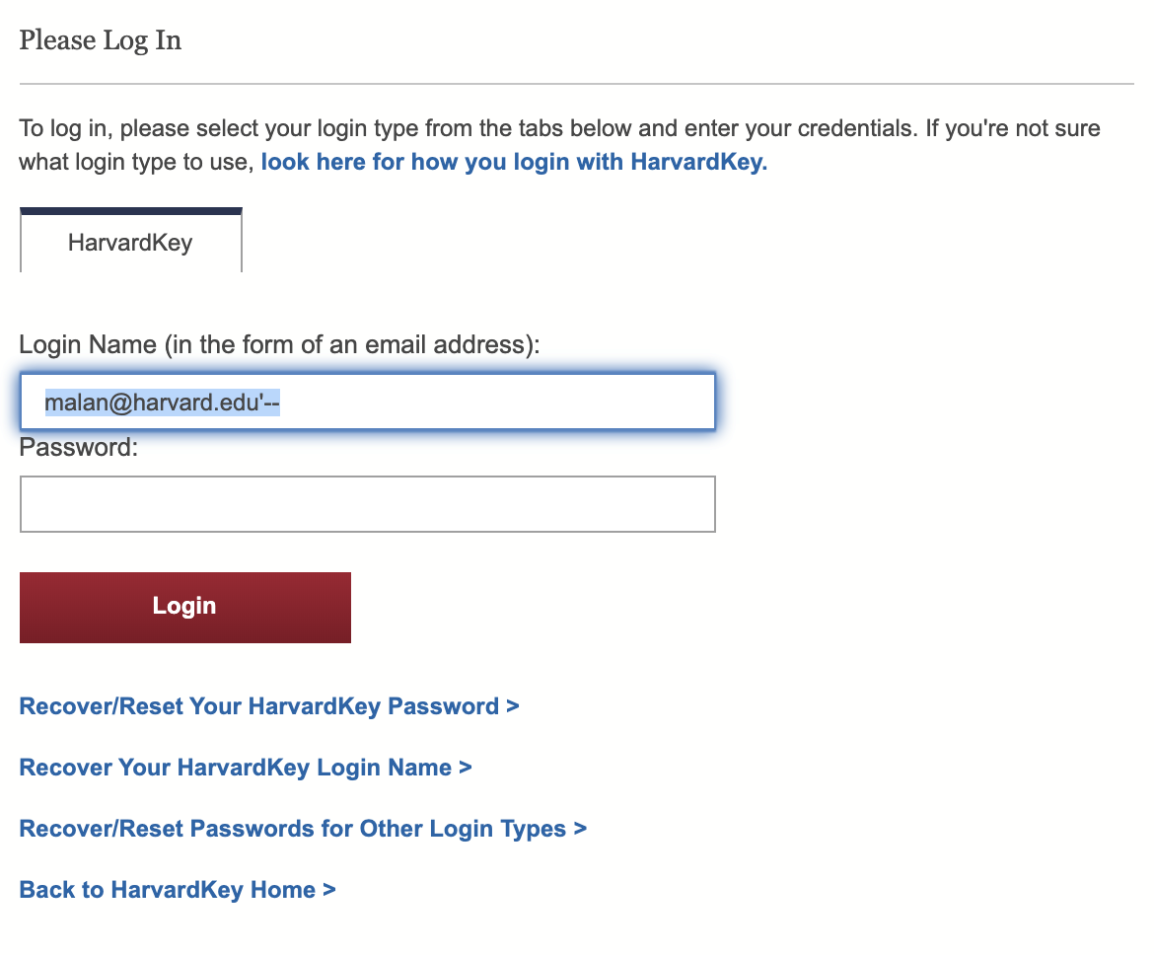

Slide 64
rows = db.execute("SELECT * FROM users WHERE username = ? AND password = ?", username, password)
if len(rows) == 1:
# Logged in!

Slide 65
rows = db.execute("SELECT * FROM users WHERE username = ? AND password = ?", username, password)
if len(rows) == 1:
# Logged in!

Slide 66
rows = db.execute("SELECT * FROM users WHERE username = ? AND password = ?", username, password)
if len(rows) == 1:
# Logged in!

Slide 67
rows = db.execute(f"SELECT * FROM users WHERE username = '{username}' AND password = '{password}'")
if len(rows) == 1:
# Logged in!

Slide 68
rows = db.execute(f"SELECT * FROM users WHERE username = '{username}' AND password = '{password}'")
if len(rows) == 1:
# Logged in!

Slide 69
rows = db.execute(f"SELECT * FROM users WHERE username = 'malan@harvard.edu'--' AND password = '{password}'")
if len(rows) == 1:
# Logged in!

Slide 70
rows = db.execute(f"SELECT * FROM users WHERE username = 'malan@harvard.edu'--' AND password = '{password}'")
if len(rows) == 1:
# Logged in!

Slide 71
rows = db.execute("SELECT * FROM users WHERE username = ? AND password = ?", username, password)
if len(rows) == 1:
# Logged in!

Slide 72
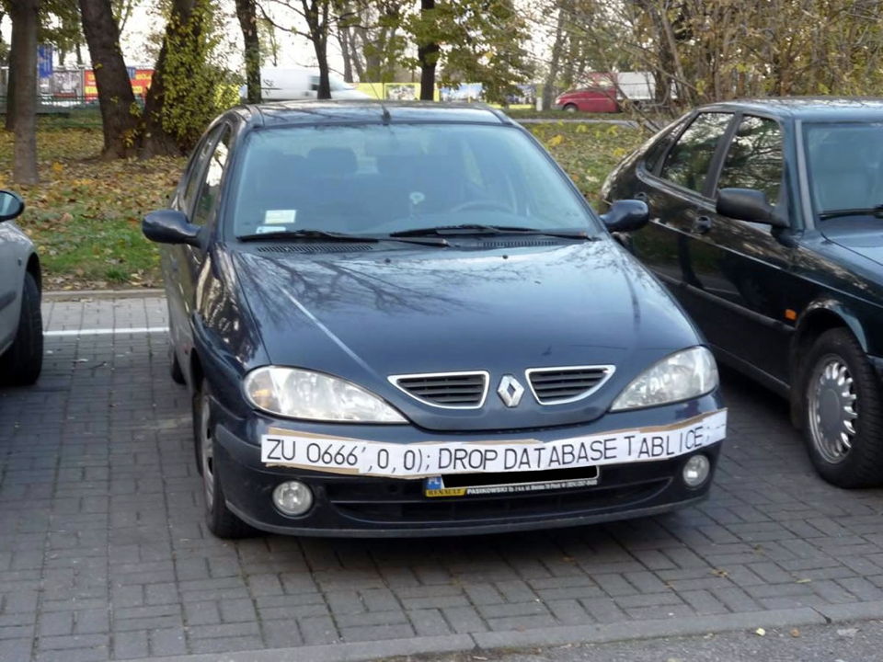

Slide 73
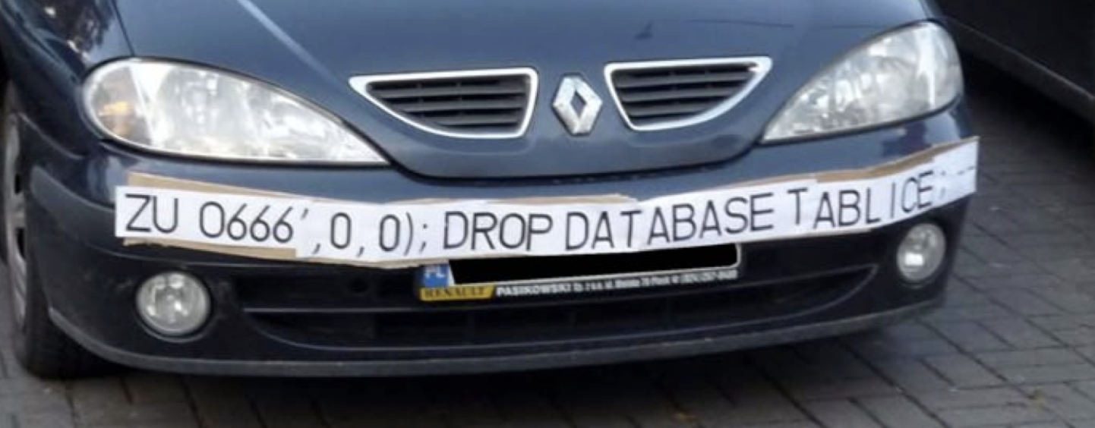

Slide 74
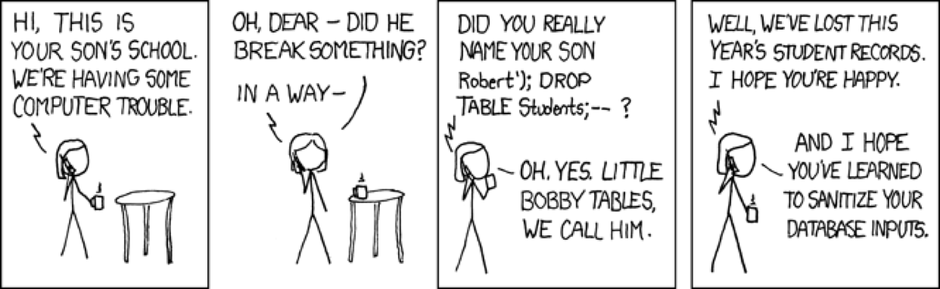
xkcd.com/327

Slide 75
This is CS50

